Slide 1
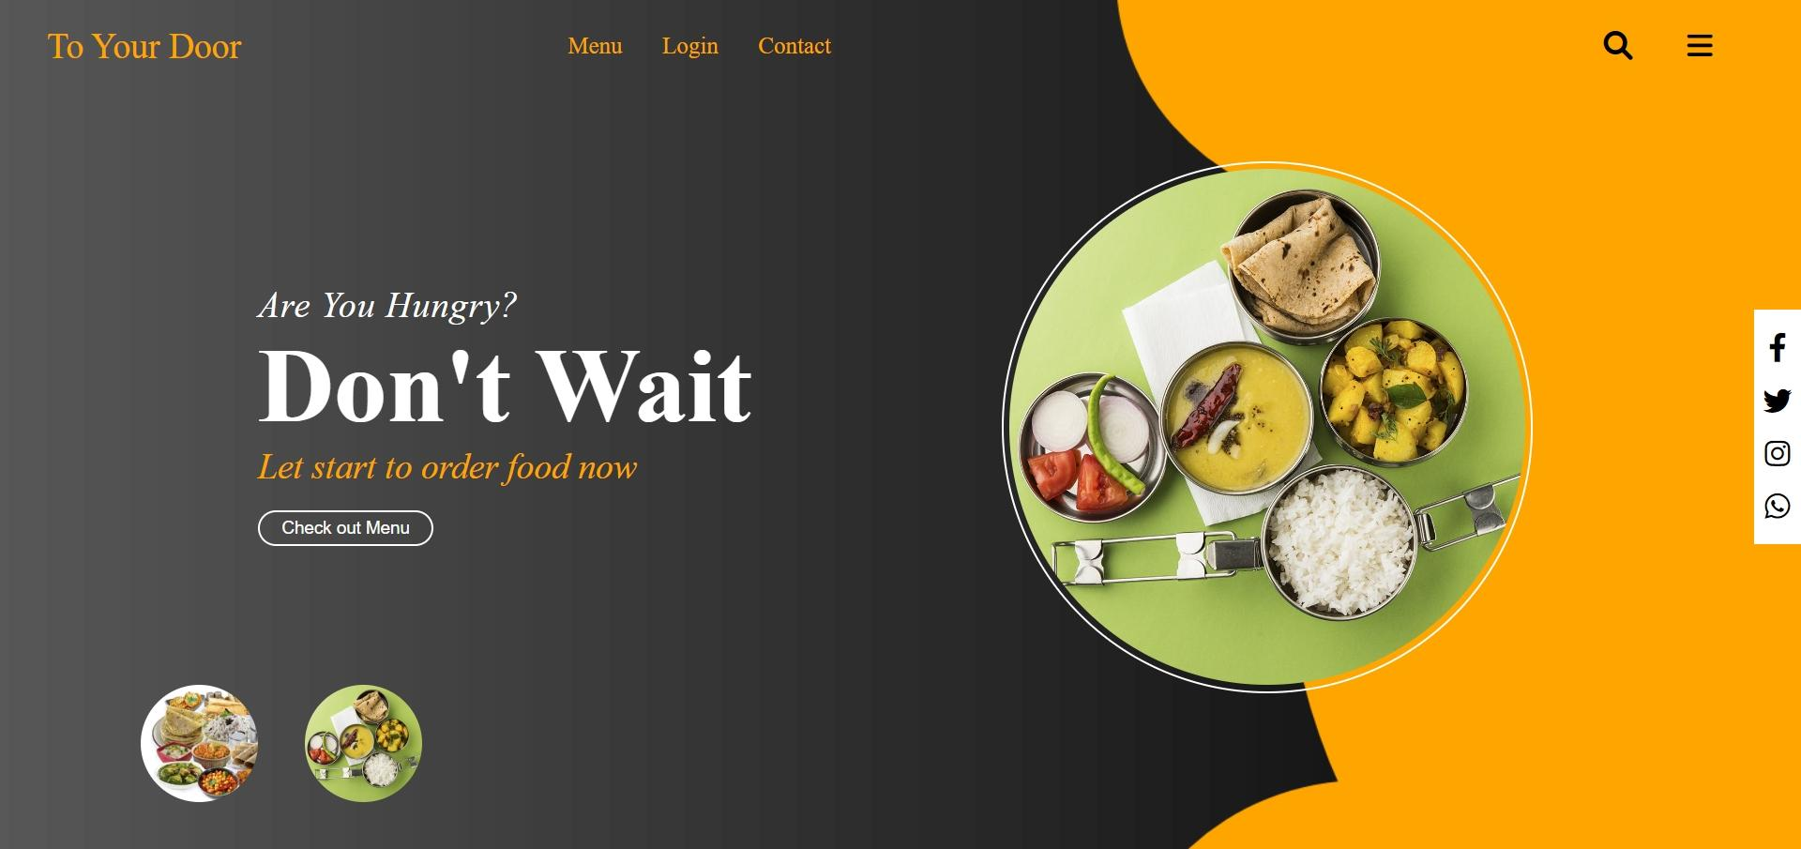
TO YOUR DOOR

Slide 2
GROUP MEMBERS
HIMANSHI GUPTA (2100300130064)
AGRIMA SRIVASTAVA (2100300130011)
KANISHKA BHARDWAJ (2100300130067)
KHUSHI JAIN (2100300130071)

Slide 3
INTRODUCTION
This project deals with the real-life problem of finding a job platform for the people who could not leave homes but wish to earn money and also it does not include need of any computerized skills but only the talent to cook good food and serve the people who live away from their homes. Eating unhealthy or junk regularly make students or employees run to doctors and build severe health related issues. They did not have enough time to carry their lunch with themselves. Therefore, there was a need to deliver lunch box emerged, which could allow them to leave their homes early and yet expect the home cooked food reach their workplace. To address the specific need of these people, the Dabbawallaservice in 1890 came into existence as Home-made food is always considered to be the most healthy and complete source of meal.

Slide 4
Literature Survey
Arora (2014) found in this study that tiffin service is an emerging sector of the economy and playing a significant role in the current scenario. Visionary people are entering in this sector due to its increasing demand and they are perceiving the wants of consumers due to their hectic life. Finding of this empirical research was suggesting that the success of tiffin service provide depend on varied factors like, quality food at reasonable price and timely delivery of tiffin. Tiffin service provider must promote their services very effectively.
Sinha (2015) tiffin service is becoming a career option for the people, and they are entering into this business. It is a micro entrepreneur business which provide sense of freedom. It is a recession proof business which can be start very easily.

Slide 5
3. Ganapathy (2016) conducted an empirical study to know the
feasibility of introducing the dabbawalla delivery service
model of Mumbai in Bengaluru and found that there is need
and demand for homemade food is growing but the exact
replication of dabbawalla delivery system is not possible due
to cultural and infrastructural difference between them.
4. Verma (2018) tiffin service provider helping those parents who
are busy in their hectic life, and do not get enough time to
prepared food for their children. They provide healthy, tasty,
and nutritious food to their children on time.

Slide 6
5. Desai and Dhawan (2021) during the covid nineteenmany people started tiffin service to help covid patient by providing them food. now they involved in this business by understanding the needs and increasing demand of tiffin service.

Slide 7
METHODOLOGY
It is beneficial for both the parties’ users and providers. Tiffin service provider
helping people by providing them healthy food, they enjoy number of
benefits.
It provides fresh, tasty, and healthy food to the customer. healthy food is vital requirement for a body. They provide good quality food compared to street food. Because it is home-made food which is prepared in their home kitchen by the women. They provide fresh, nutritious, tasty food to their customer, which help to reduce the risk of disease such hypertension, diabetes, cancer, and obesity.
It serves variety in food, as no one can eat single type of food every day. To avoid monotony in food people, want variety in their meal. tiffin service provider offers a menu to their customer with variety of food.
It is affordable for the people.

Slide 8
TECHNOLOGY
Our website consists of basic technologies used for frontend and backend. They are
listed as:
HTML:- The HyperText Markup Language or HTML is the standard markup language for documents designed to be displayed in a web browser. It defines the meaning and structure of web content. It is often assisted by technologies such as Cascading Style Sheets and scripting languages such as JavaScript.
CSS:- Cascading Style Sheets is a style sheet language used for describing the presentation of a document written in a markup language such as HTML or XML. CSS is a cornerstone technology of the World Wide Web, alongside HTML and JavaScript.

Slide 9
JS:- JavaScript, often abbreviated as JS, is a programming language that is one of the core technologies of the World Wide Web, alongside HTML and CSS.
Google Sheets:- Google Sheets is a spreadsheet application included as part of the free, web-based Google Docs Editors suite offered by Google. Google Sheets is available as a web application; a mobile app for: Android, iOS, and as a desktop application on Google's ChromeOS.

Slide 10
CONCLUSION
It is obvious that tiffin service industry is one of the emerging sectors of the Indian economy and playing a significant role in the life of students and office goers. They are providing fresh, and healthy food, delivered on time that fix a schedule for eating, quality food at reasonable price, and saves time of user. Though, it has some limitations such as, fixed amount of food for everyone, lack of warmth in food, and poor packaging. Despite these demerits, it is very beneficial for people who are living away from their home and busy in their hectic life. During covid-19 many people started tiffin service to help covid patient by providing them healthy food. At present, this industry providing employment to many people and visionary people are entering into this industry, understanding the needs of people, and increasing demand of tiffin service. The future of tiffin service is bright due to the busier life of people.

Slide 11
FUTURE WORK
For now we have developed a job platform for the job doers that seek to find a comfortable platform to attract consumers in nearby areas. In future we wish to add the means so that consumers could reach the suppliers directly by registering on the same platform as a consumer so that they could find cook of their own choice as per their budgets and preferences so that they could contact directly among themselves.

